Slide 1
Bank Loan Case Study Exploratory Data Analysis (EDA)
BY LAVANYA B

Slide 2
Project Description
In this project, I take on the role of a data analyst at a finance company specializing in loans for urban customers. The company faces two major risks:
Approving loans for applicants who cannot repay, leading to financial loss.
Rejecting applicants who can repay, causing a loss of business.
Using Exploratory Data Analysis (EDA), my goal is to analyze customer and loan attributes to identify patterns that influence loan defaults. This analysis will help the company make better decisions regarding loan approvals, interest rates, and risk management.

Slide 3
Approach
To tackle this problem, I followed a structured approach using Microsoft Excel:
Identifying and Handling Missing Data – Ensuring data completeness and accuracy.
Detecting and Addressing Outliers – Avoiding misleading results by treating extreme values.
Analyzing Data Imbalance – Understanding target variable distribution.
Conducting Univariate, Segmented Univariate, and Bivariate Analysis – Extracting meaningful insights.
Finding Top Correlations in Different Segments – Identifying key indicators of loan default.
I used Excel formulas, pivot tables, and visualization tools to explore patterns in loan defaults.

Slide 4
Tech-Stack Used
Microsoft Excel 2019: Data Cleaning, Formulas, Pivot Tables, Charts, and Correlation Analysis.
Excel Functions Used: COUNT, ISBLANK, IF, AVERAGE, MEDIAN, QUARTILE, IQR, CORREL, COUNTIF.
Visualizations: Bar Charts, Scatter Plots, Correlation Heatmaps.

Slide 5
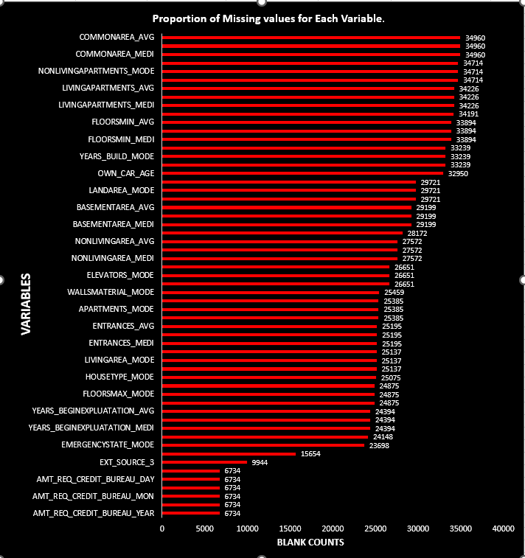
Insights & Analysis TASK A: Handling Missing Data
Used COUNT ,IF and ISBLANK functions to detect missing values.
Replaced missing numerical data using median imputation to prevent skewing analysis.
Created a bar chart to visualize missing values in key variables.

Slide 6
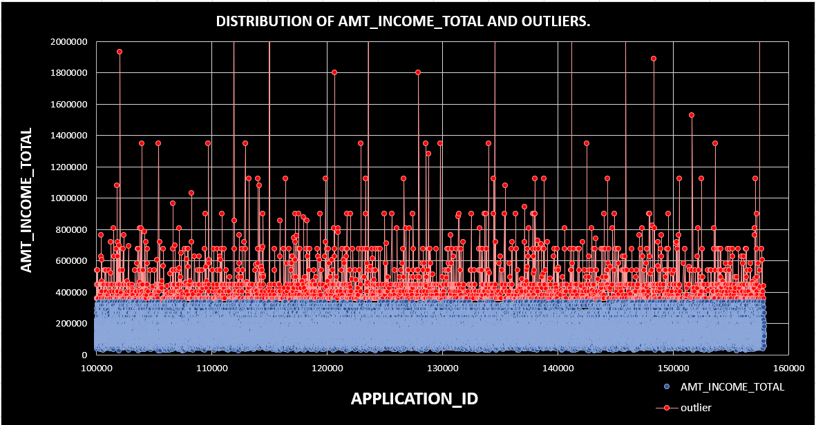
TASK B: Identifying and Handling Outliers
Used QUARTILE and Interquartile Range (IQR) to detect outliers.
Created Scatter plot to visualize outliers in AMT_INCOME_TOTAL.
Outliers in AMT_INCOME_TOTAL (showing unrealistic income) were marked for investigation.

Slide 7
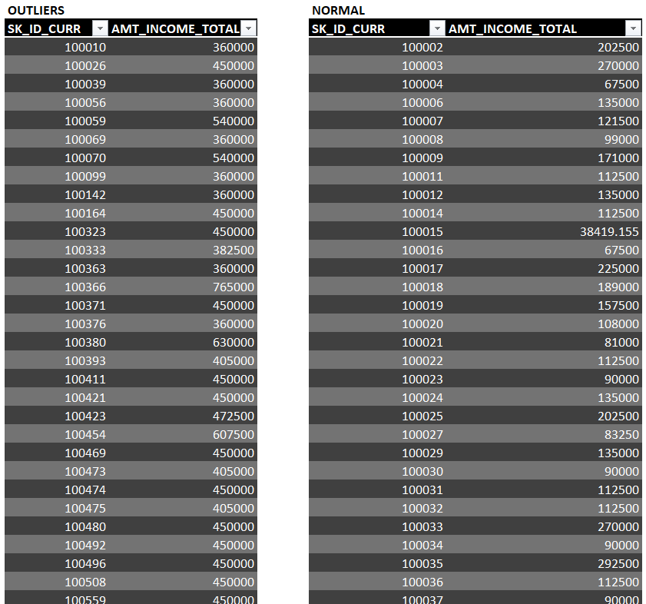
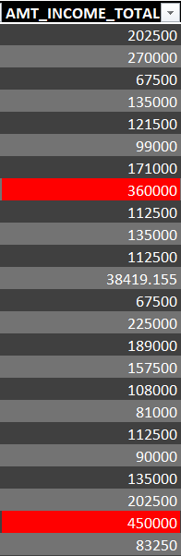
I attached few rows of outliers that identified and marked as red and filtered the rows to extracted outliers and other rows as separate table and done with the visualization

Slide 8

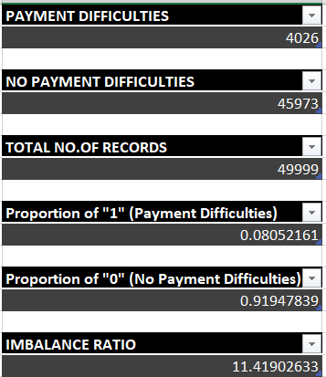
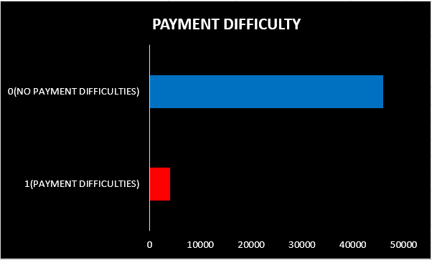
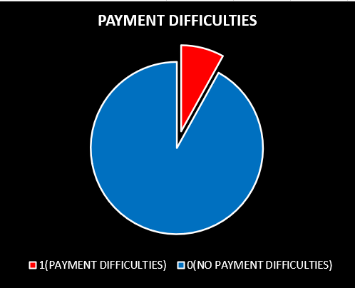
TASK C: Data Imbalance Analysis
Used COUNTIF to compare TARGET = 1 (payment difficulties) vs. TARGET = 0 (others).
Found class imbalance, indicating fewer loan defaults but with significant financial impact.
Created a pie chart and bar chart to illustrate the imbalance.

Slide 9
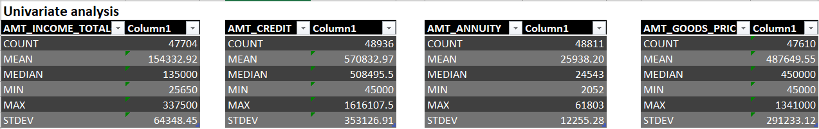
TASK D: Univariate, Segmented Univariate & Bivariate Analysis
Univariate Analysis:
Used COUNT, AVERAGE, MEAN,MIN,MAX,STDEV.P formulas to calculate descriptive analysis.
Created histograms for AMT_INCOME_TOTAL, AMT_CREDIT, AMT_ANNUITY and AMT_GOODS_PRICE by using descriptive analysis.

Slide 10
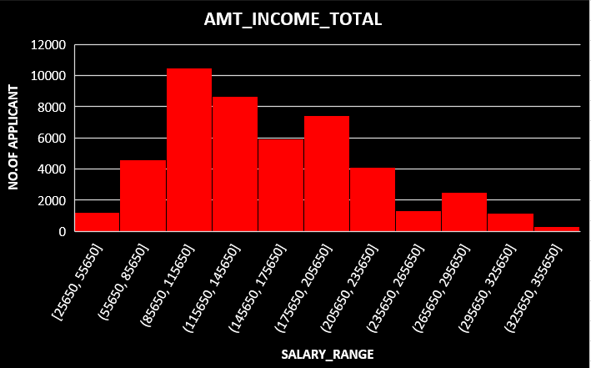
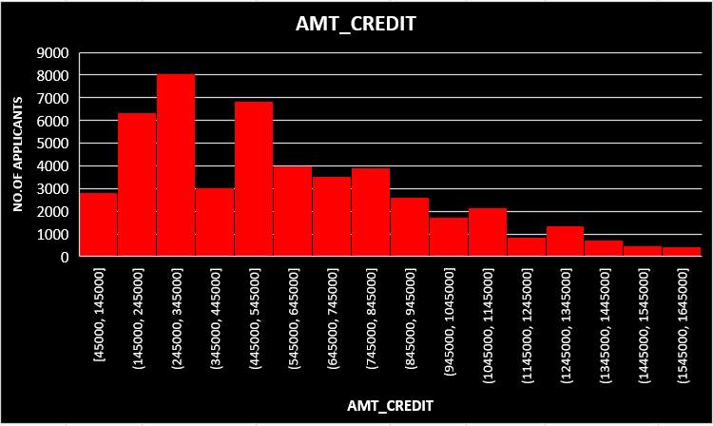
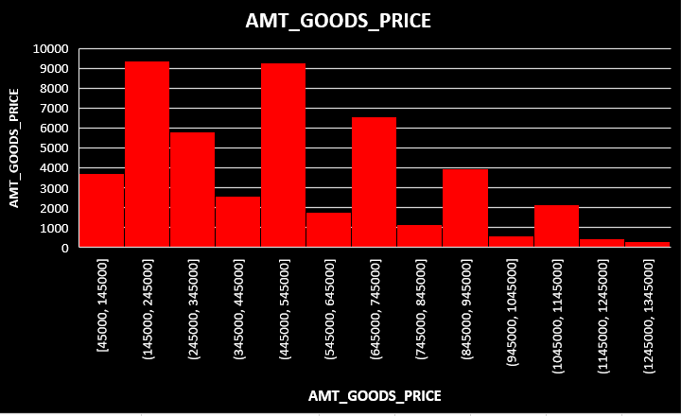
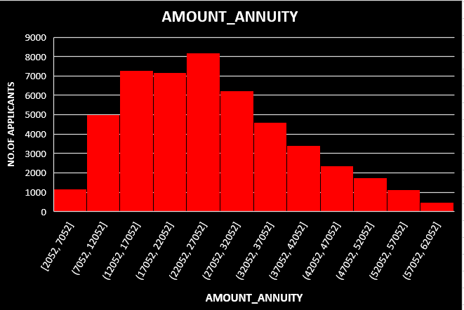

Slide 11
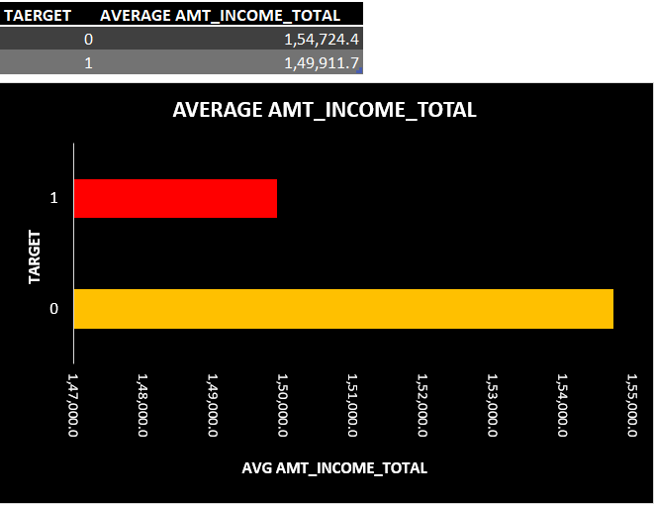
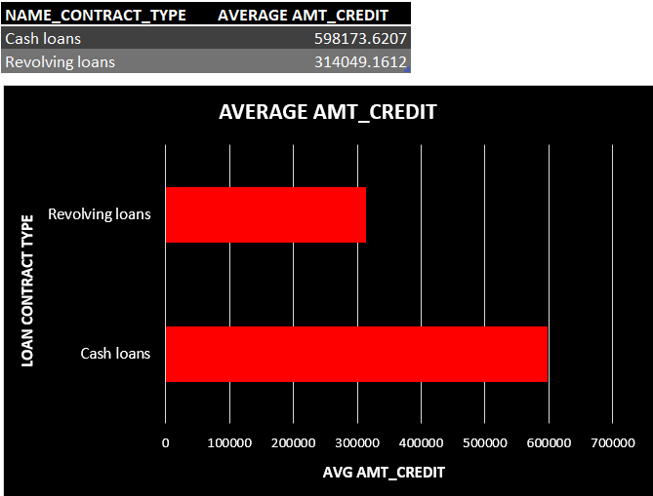
Segmented Univariate Analysis:
Compared AMT_CREDIT distributions for LOAN CONTRACT TYPE (revolving loans and cash loans)
Observed that higher credit amounts correlated with cash loans.
Compared AMT_INCOME_TOTAL distributions for TARGET = 1 vs. TARGET = 0.
Observed that higher income amounts correlated with increased defaults.

Slide 12
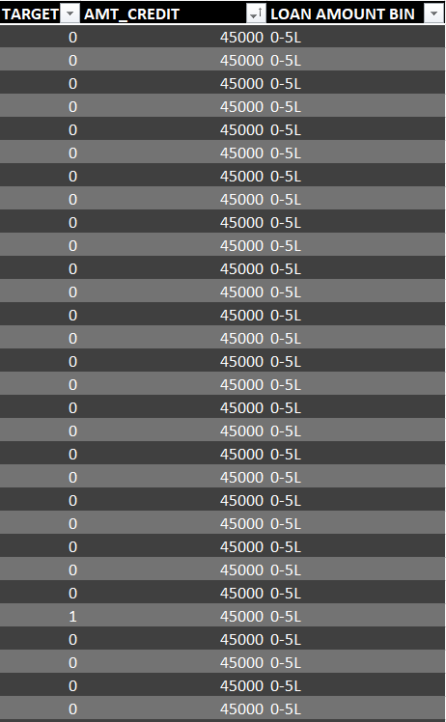
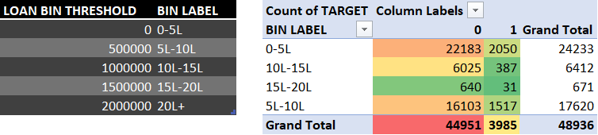
Bivariate Analysis:
Created heatmaps to analyze relationships between variables.
AMT_CREDIT vs. TARGET showed a moderate correlation.
Created Loan bin threshold with Bin label, then created column as Laon amount bin to identify the range.
Created pivot table to count no.of applicants falls on the target 0 or 1 in a specific range and done with heat map with Red-Yellow-Green color scale to visually represent default rates across loan bins.
Few rows attached with loan amount bin column

Slide 13
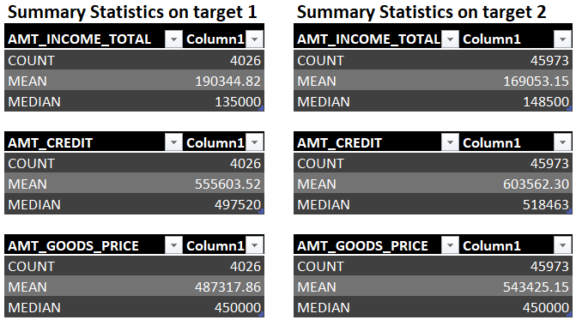
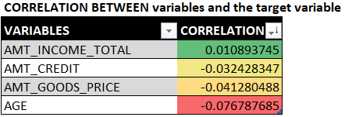
TASK E: Identifying Top Correlations for Loan Defaults
Used CORREL function to calculate correlation between variable and target variable individually without segmenting data. When I segemented and tried to calculate correl, the target column have same value in all rows that can’t calculate correl.
Segmented the data into clients with payment difficulties (TARGET = 1) and all others (TARGET = 0). Then calculated descriptive analysis to get meaningful analysis.
AMT_INCOME_TOTAL have positive relationship with TARGET.
Created a correlation heatmap to highlight the strongest relationships.

Slide 14
Results & Key Takeaways
Higher loan amounts (AMT_CREDIT) are associated with increased default risk, especially when income is low.
Data imbalance in the target variable suggests the need for careful handling in predictive modeling.
Income & Credit Amount are strong indicators of default risk.
Lower income applicants tend to have a higher loan default rate.

Slide 15
Drive Link & Excel File
Excel File of this Bank Loan Case study project
(click above to get excel file)
Video Presentation
(click above to get video presentation)
This report and video presentation will be available for reference and further refinements

Slide 16
Final Thoughts
This project provided hands-on experience in EDA using Excel. I developed skills in data cleaning, statistical analysis, and visualization to extract insights from real-world financial data.
These insights can aid in risk management and data-driven decision-making for loan approvals.

Slide 17
THANK YOU
I appreciate the opportunity to work on this project and gain valuable insights into loan default analysis. This exploration has deepened my understanding of financial risk factors and data-driven decision-making. Looking forward to applying these learnings in future projects!
BY LAVANYA B

